Slide 1
qty and sales management
3조
B289008 김근홍
B289012 김대연
B289046 박현웅

Slide 2
Contents.
1.
목적
2.
ER-
Diagram
3.
DateBase
table
4.
Html&php
code
5.
시현

Slide 3
1. 목적
기업들이 각 대리점들을 지점장부터 판매량까지 관리하기 위한 데이터베이스
각 대리점들의 판매량 분석을 통하여 어떤 대리점에서 어떤 제품이 잘 팔리는지
알아 볼 수 있는 데이터베이스

Slide 4
2. ER - Diagram
C_Qty
Year
A_address
A_phone
Price
G_name
C#
Area
A#
Area
G#
G_calorie
Company
Agency
Goods
manage
analysis
1
n
n
n
1
n
search
n
1
AG
Owner
A#
G#
A#
O_age
A_sales
A_Qty
O_name
O#

Slide 5
3. DateBase Table
테이블 생성 SQL문
CREATE TABLE `company` (
`C#` VARCHAR(5) NULL DEFAULT NULL,
`C_QTY` INT(11) NULL DEFAULT NULL,
`YEAR` INT(11) NOT NULL,
`AREA` VARCHAR(20) NOT NULL,
PRIMARY KEY (`AREA`))
COLLATE='utf8_general_ci'
ENGINE=InnoDB;
CREATE TABLE `agency` (
`A#` VARCHAR(5) NOT NULL,
`A_ADDRESS` VARCHAR(50) NOT NULL,
`A_PHONE` VARCHAR(20) NOT NULL,
`AREA` VARCHAR(20) NOT NULL,
PRIMARY KEY (`A#`),
INDEX `AREA` (`AREA`),
CONSTRAINT `agency_ibfk_1`
FOREIGN KEY (`AREA`)
REFERENCES `company` (`AREA`)
ON DELETE CASCADE)
COLLATE='utf8_general_ci'
ENGINE=InnoDB;
CREATE TABLE `owner` (
`O#` VARCHAR(5) NULL DEFAULT
NULL,`O_name` VARCHAR(10) NOT
NULL, `A#` VARCHAR(5) NOT NULL,
`O_age` INT(11) NOT NULL, INDEX
`A#` (`A#`),
CONSTRAINT `owner_ibfk_1`
FOREIGN KEY (`A#`)
REFERENCES`agency` (`A#`) ON
DELETE CASCADE)
COLLATE='utf8_general_ci'
ENGINE=InnoDB;
CREATE TABLE `goods` (
`G#` VARCHAR(5) NOT NULL,
`G_PRICE` INT(11) NOT NULL,
`G_NAME` VARCHAR(20) NOT NULL,
`G_CALORIE` INT(11) NOT NULL,
PRIMARY KEY (`G#`))
COLLATE='utf8_general_ci'
ENGINE=InnoDB;
CREATE TABLE `ag` (
`A#` VARCHAR(5) NOT NULL,
`G#` VARCHAR(5) NOT NULL,
`A_QTY` INT(11) NULL DEFAULT NULL,
`A_SALES` INT(11) NULL DEFAULT NULL,
INDEX `A#` (`A#`),
INDEX `G#` (`G#`),
CONSTRAINT `ag_ibfk_1`
FOREIGN KEY (`A#`)
REFERENCES `agency` (`A#`)
ON DELETE CASCADE,
CONSTRAINT `ag_ibfk_2`
FOREIGN KEY (`G#`)
REFERENCES `goods` (`G#`)
ON DELETE CASCADE)
COLLATE='utf8_general_ci'
ENGINE=InnoDB;

Slide 6
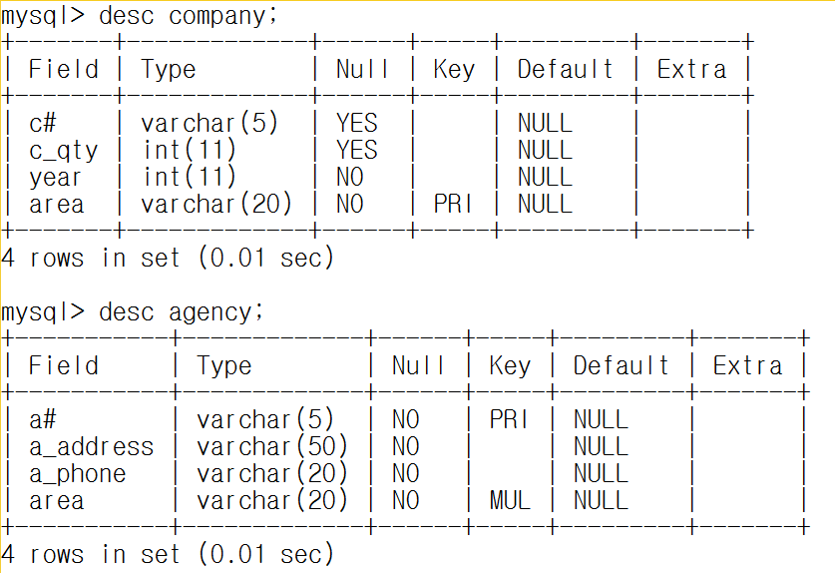
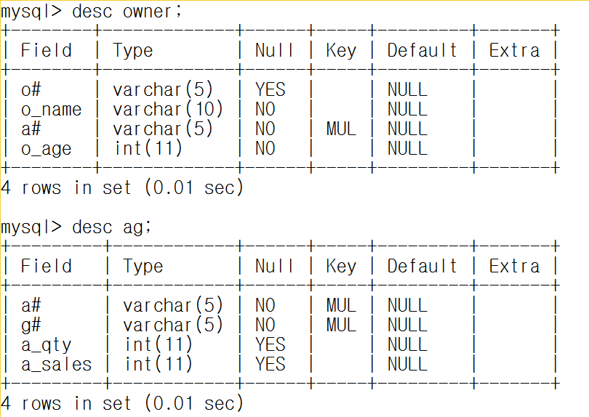
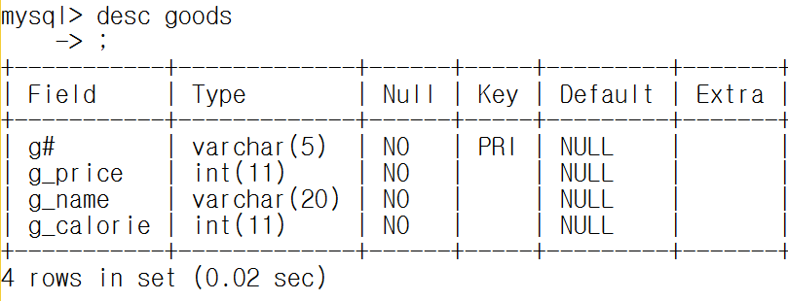
3. DateBase Table
생성된 DateBase Table

Slide 7
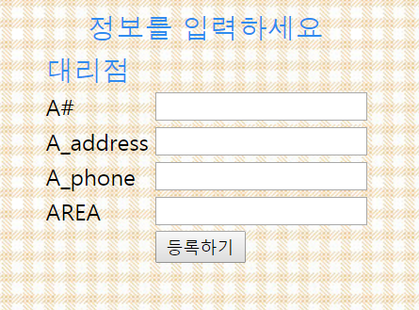
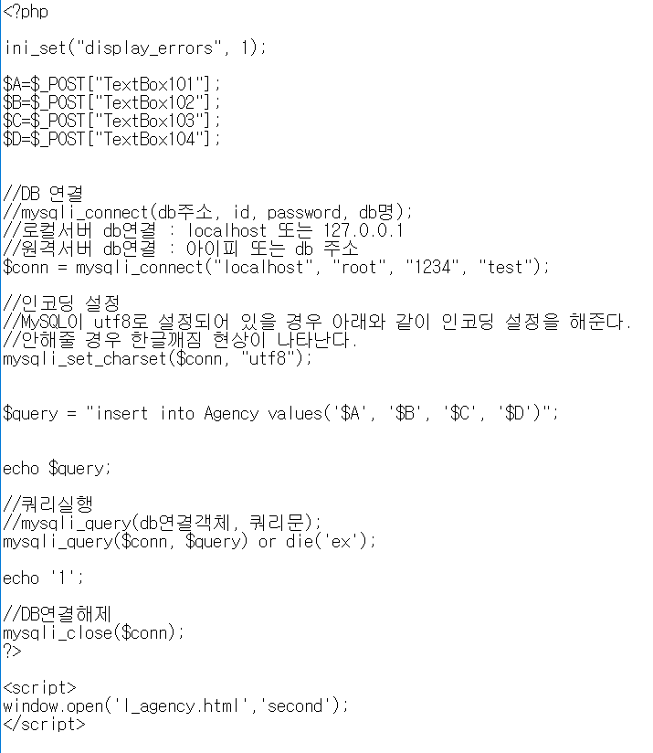
4. HTML&php code
INPUT (agency)
HTML 실행
php code
6

Slide 8
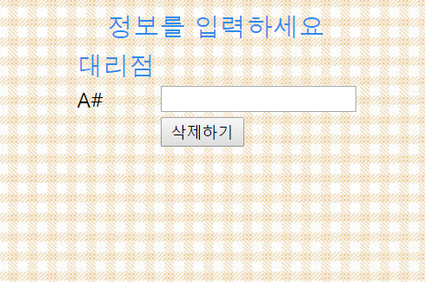
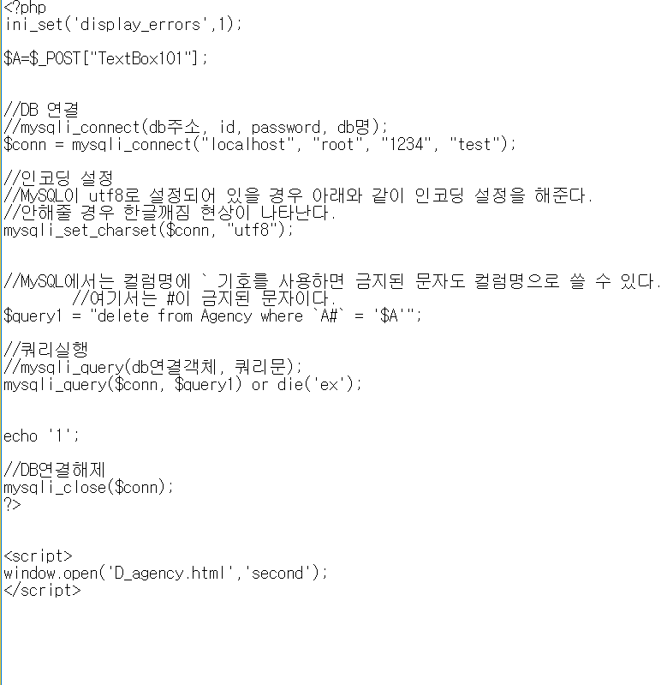
4. HTML&php code
Delete (agency)
HTML 실행
php code
7

Slide 9
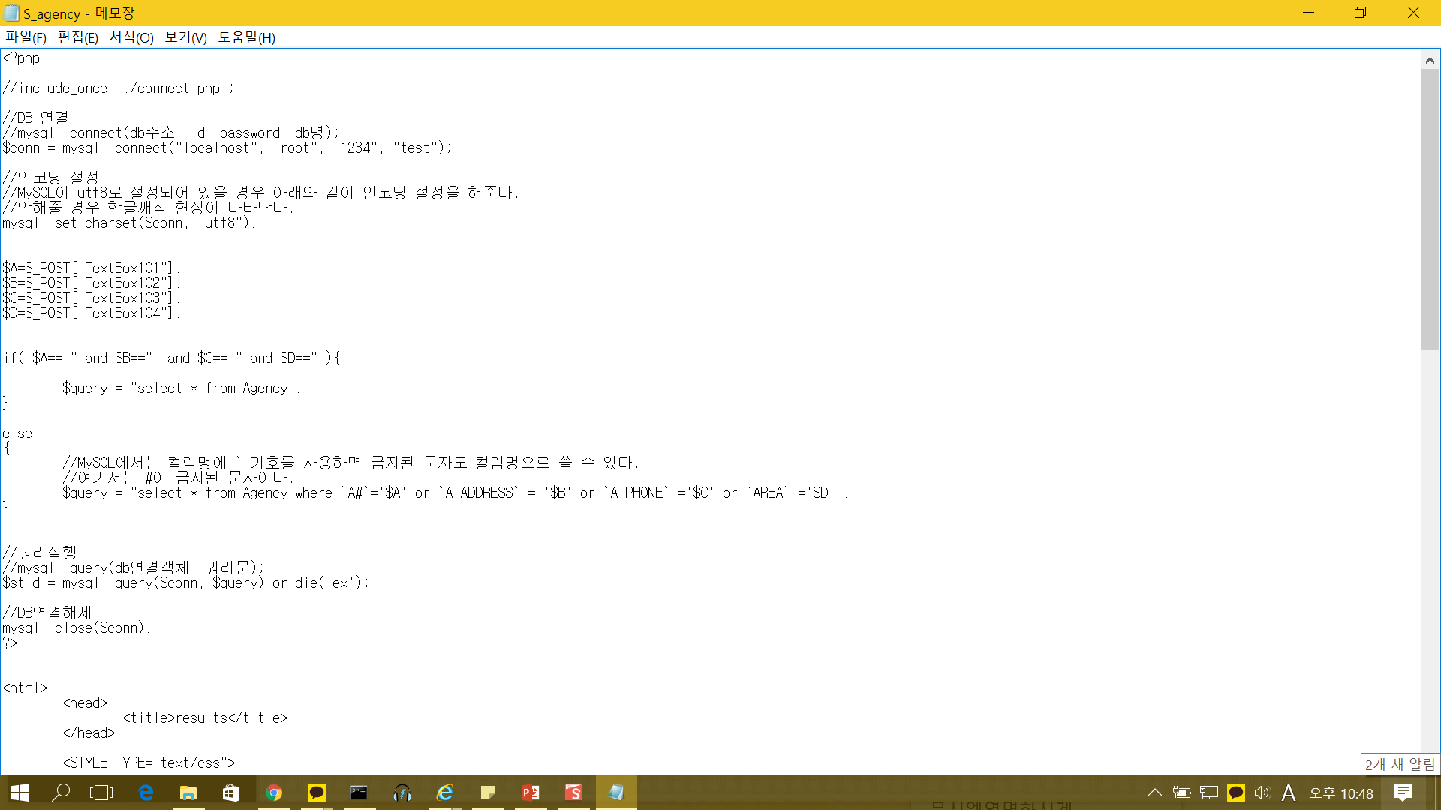
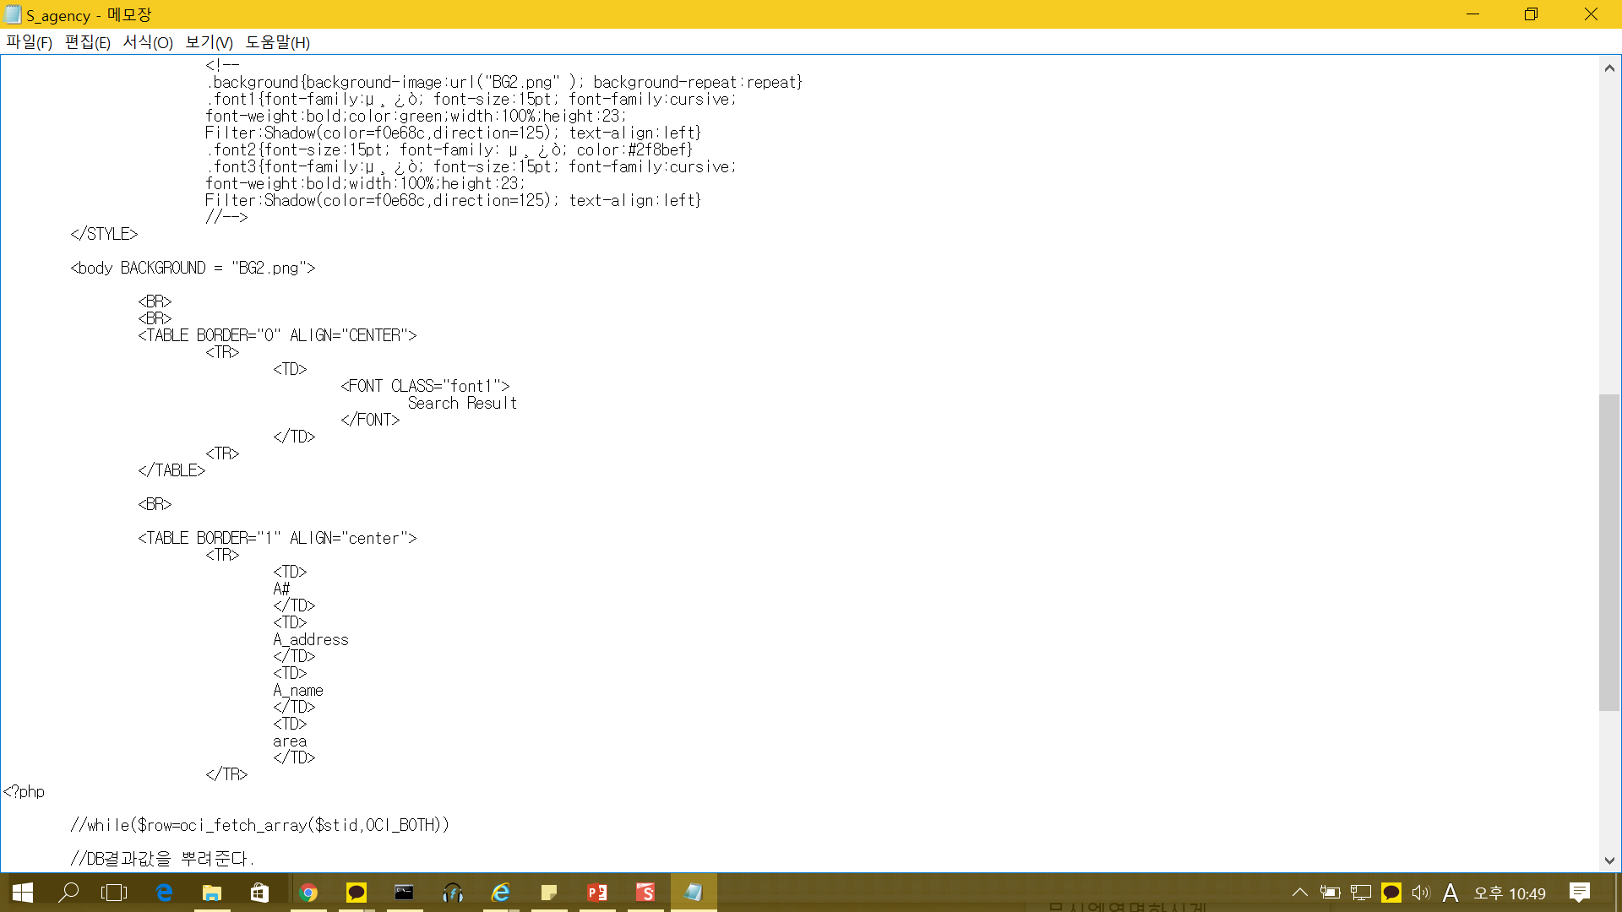
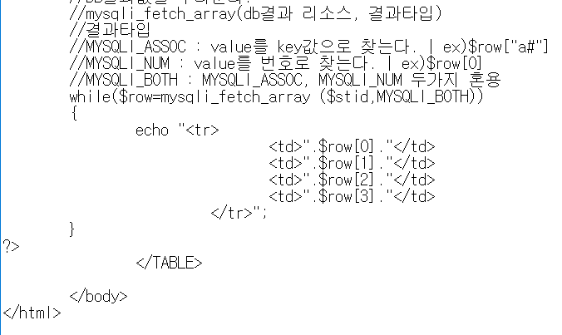
4. HTML&php code
Select (agency) php code
php code

Slide 10
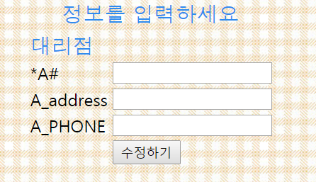
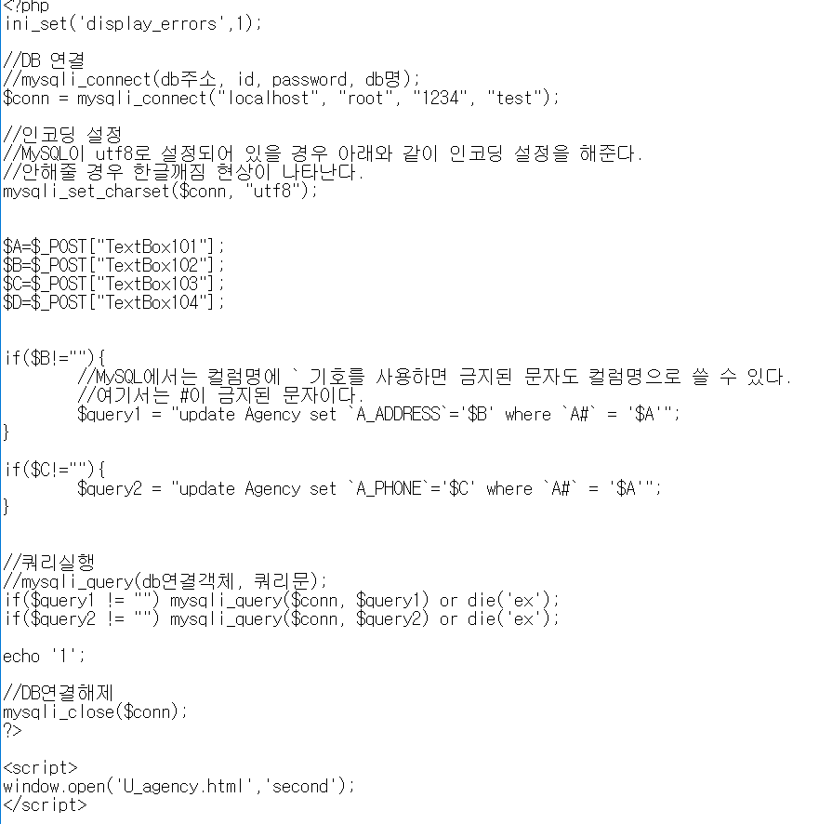
4. HTML&php code
Update (agency)
HTML 실행
php code

Slide 11
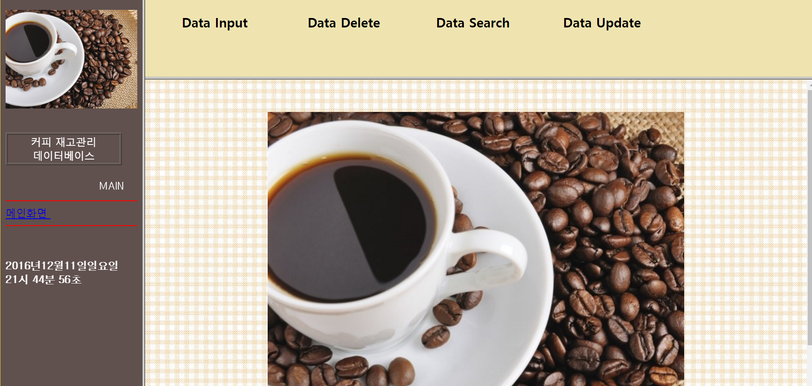
5. 시현
HTML&php 시현 구동

Slide 12
Thank
You!

